Slide 1

Introduction to jenkins

Slide 2
Agenda
CI concepts
Jenkins CI server overview
Installing and running jenkins
Administering jenkins
Jobs and builds in jenkins
Jenkins plugins
Securing jenkins
Distributed builds
CD pipelines
Best practices in CI/CD process with jenkins

Slide 3
CI concepts
Continuous integration (CI) implements continuous processes of applying quality control - small pieces of effort, applied frequently.
Continuous integration aims to improve the quality of software, and to reduce the time taken to deliver it, by replacing the traditional practice of applying quality control after completing all development.
Ref: http://en.wikipedia.org/wiki/Continuous_integration

Slide 4
History
Continuous Integration emerged in the Extreme Programming (XP) community, and XP advocates Martin Fowler and Kent Beck first wrote about continuous integration circa 1999.

Slide 5
Continuous Integration
Continuous Integration is a software development practice where members of a team integrate their work frequently, usually each person integrates at least daily - leading to multiple integrations per day.
Each integration is verified by an automated build (including test) to detect integration errors as quickly as possible.
-- Martin Fowler
Ref: http://martinfowler.com/articles/continuousIntegration.html
Notes:
‹#›

Slide 6
Why Continuous Integration?
Integration is hard, effort increase exponentially with
Number of components
Number of bugs
Time since last integration
Ref: http://www.slideshare.net/carlo.bonamico/continuous-integration-with-hudson

Slide 7
Continuous Integration Benefit
Project Management
Detect system development problems earlier
Reduce risks of cost, schedule, and budget
Code Quality
Measurable and visible code quality
Continuous automatic regression unit test

Slide 8
Best Practice of CI
Single Source Repository.
Automate the Build and Test
Everyone Commits Every Day
Keep the Build Fast
Everyone can see what's happening
Automate Deployment (Optional)

Slide 9
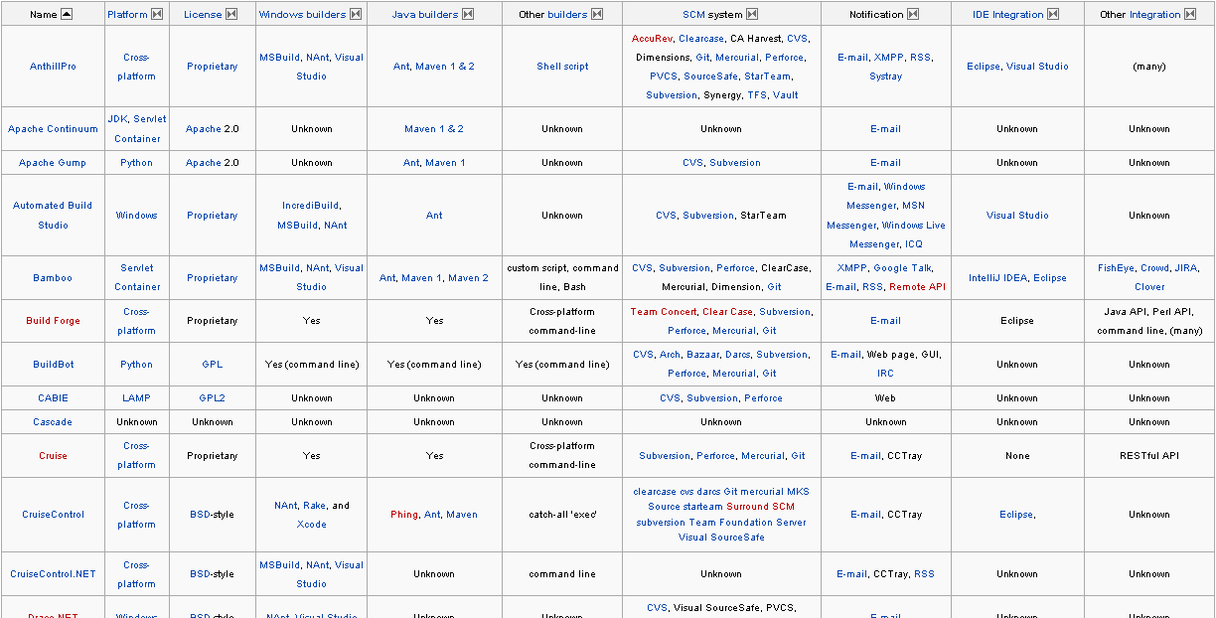
Continuous Integration Tools
Ref: http://en.wikipedia.org/wiki/Comparison_of_Continuous_Integration_Software

Slide 10

Jenkins/Hudson
Notes:
‹#›

Slide 11
What’s Jenkins/Hudson
An open source CI server
More then 23000 installations (Jul 2010)
Plug-in extensibility (Over 370 plugins)
MIT license

Slide 12
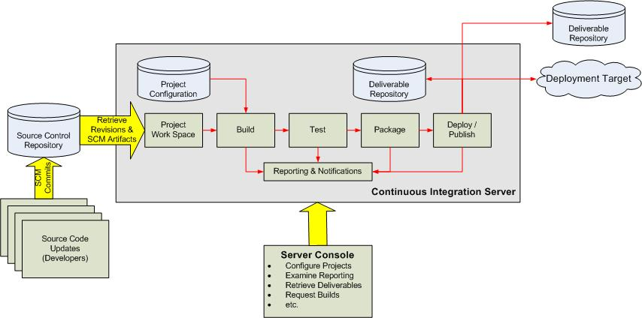
Continuous Integration Overview
Ref: http://www.javaworld.com/javaworld/jw-12-2008/images/CIOverview.jpg

Slide 13
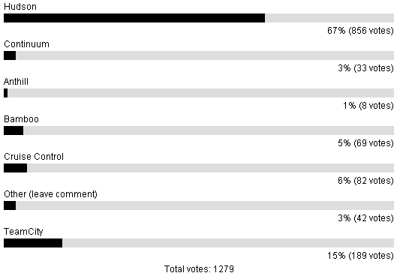
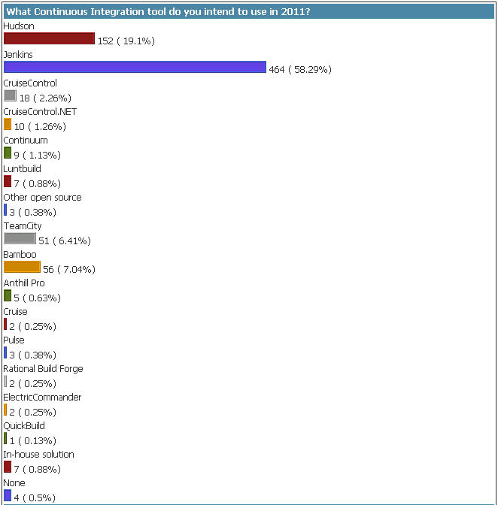
CI Tool Usage
Ref: http://java.dzone.com/node/28241/results
Total vote: 643
First Vote: 2010/02/12
Last Vote: 2011/03/08
Ref:http://www.wakaleo.com/resources/polls

Slide 14
Jenkins v.s.Hudson
Jenkins: Original Hudson team
Hudson: Oracle and Sonatype
Ref: http://jenkins-ci.org/content/hudsons-future
Notes:
‹#›

Slide 15
Jenkins Features
Trigger a build
Get source code from repository
Automatically build and test
Generate report & notify
Deploy
Distributed build

Slide 16
Jenkins Requirement
Web Server (Tomcat, WebLogic, …)
Build tool (Maven, Ant)
SCM (Git, Svn, Cvs, …)

Slide 17
Jenkins Plugins
Build triggers
Source code management
Build tools
Build wrappers
Build notifiers
Build reports
Artifact uploaders
UI plugins
Authentication and user management
Notes:
‹#›

Slide 18
Build Trigger
Manually click build button
Build periodically
Build whenever a SNAPSHOT dependency is built
Build after other projects are built
Poll SCM
IRC, Jabber, …

Slide 19
Get Source Code (1/2)
CVS (build-in)
SVN (build-in)
GIT (requires Git)
ClearCase (requires ClearCase)
Mercurial, PVCS, VSS, …

Slide 20
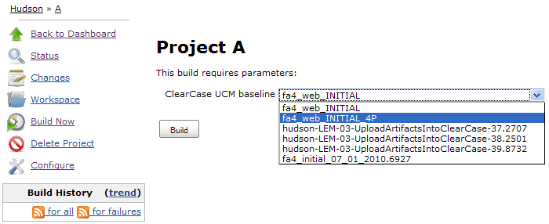
Get Source Code (2/2)
Get current snapshot
Get baseline (tag)
Notes:
‹#›

Slide 21
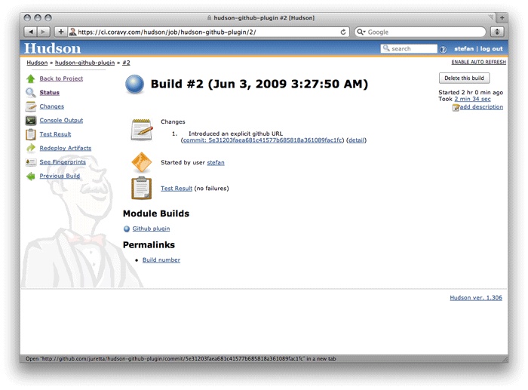
Code Change History
Notes:
‹#›

Slide 22
Build Tools
Java
Maven (build-in), Ant, Gradle
.Net
MSBuild, PowerShell
Shell script
Python, Ruby, Groovy

Slide 23
Build Wrapper
Build name (version no) setter
Virtual machine (VMWare, Virtual Box, Docker)
Set environment variable

Slide 24
Build Notifier
E-mail
Twitter
Jabber
IRC
RSS
Google calendar
…

Slide 25
Build Report
Static Code Analysis
Checkstyle, PMD, Findbugs, Compiler Warning
Test Report & Code Coverage
JUnit, TestNG, Cobertura, Clover
Open Tasks

Slide 26
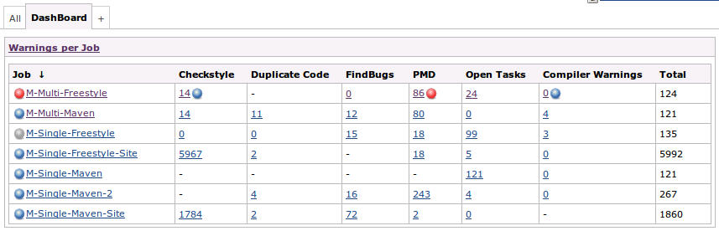
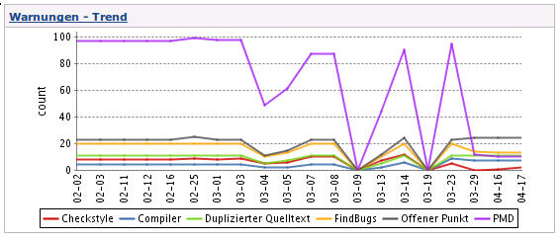
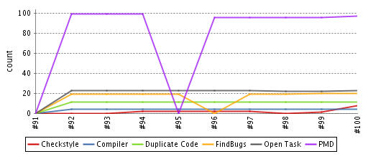
Static Code Analysis

Slide 27
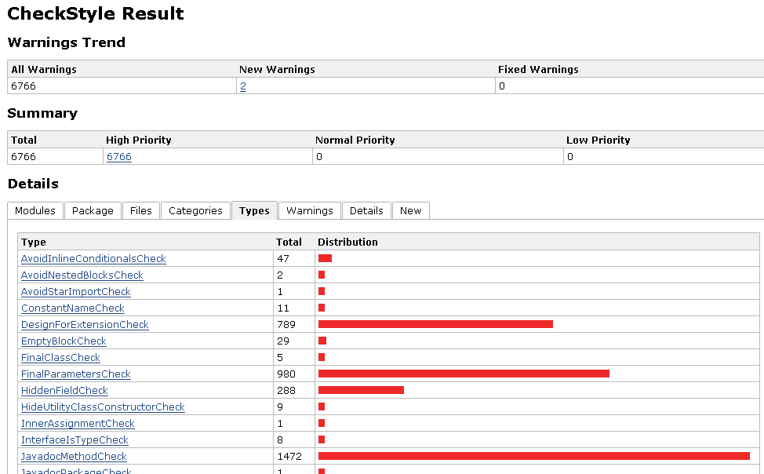
CheckStyle

Slide 28
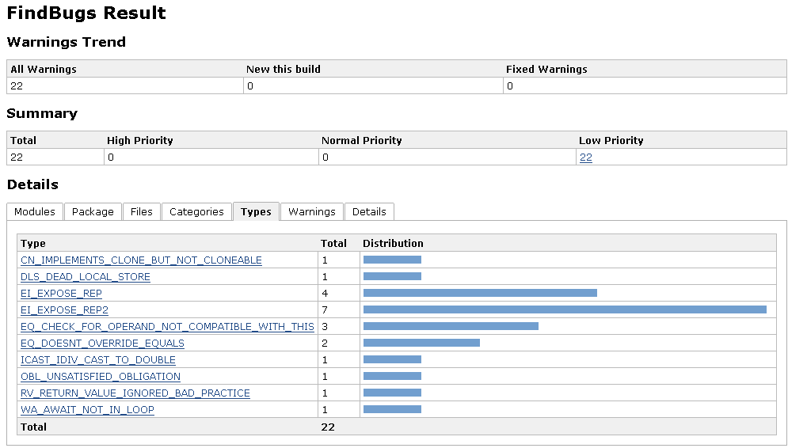
FindBugs
Notes:
‹#›

Slide 29
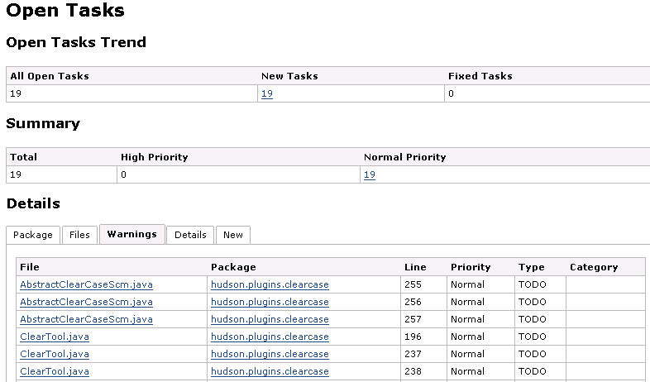
Open Tag
Notes:
‹#›

Slide 30
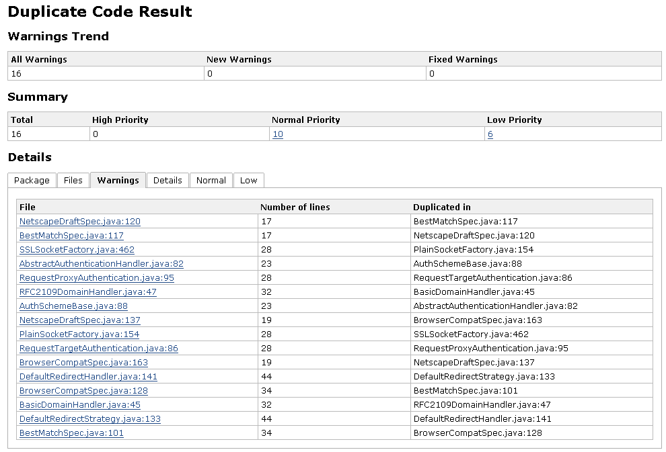
Duplicate Code
Notes:
‹#›

Slide 31
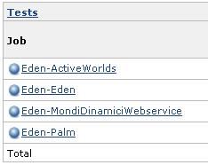
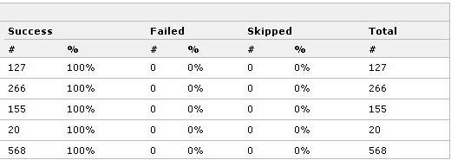
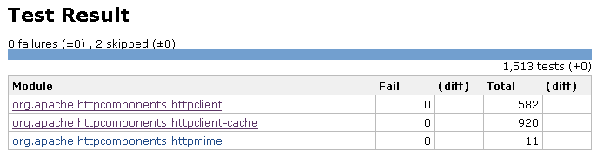
Test Report
Notes:
‹#›

Slide 32
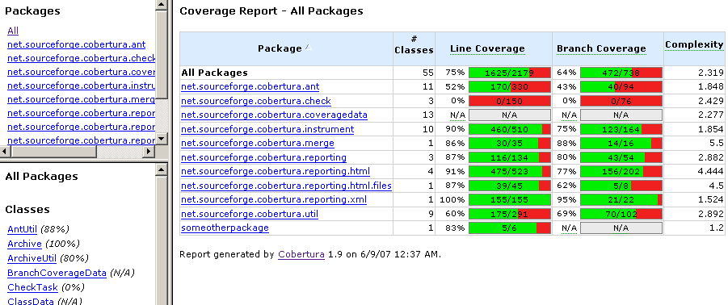
Test Code Coverage
Ref: http://cobertura.sourceforge.net/sample/
Notes:
‹#›

Slide 33
Artifact uploaders
Tomcat
JBoss
Glassfish
WebSphere
FTP
SSH
Docker
Notes:
‹#›

Slide 34
UI Enhancement
Dashboard
Sectioned view
iPhone/Android

Slide 35
Security Management
Security Realm
LDAP
Jenkins's own user database
Delegate to servlet container
Authorization
Anyone can do anything
Logged-in users can do anything
Matrix-based security
Project-based Matrix Authorization Strategy
Legacy mode

Slide 36
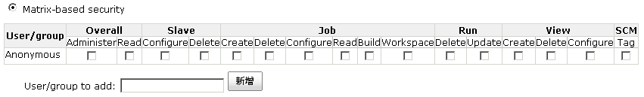
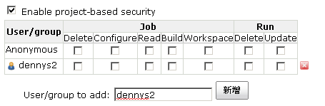
Security Management
Matrix-based security
Project-based Matrix Authorization

Slide 37
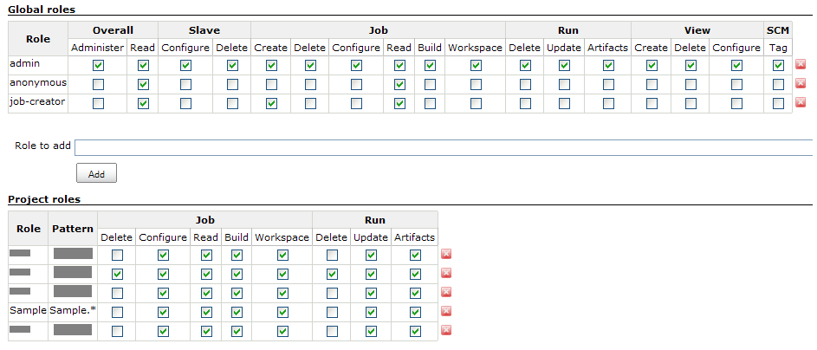
Security Management Plugins
Active directory, OpenID, MySQL, …
Role based privilege control

Slide 38
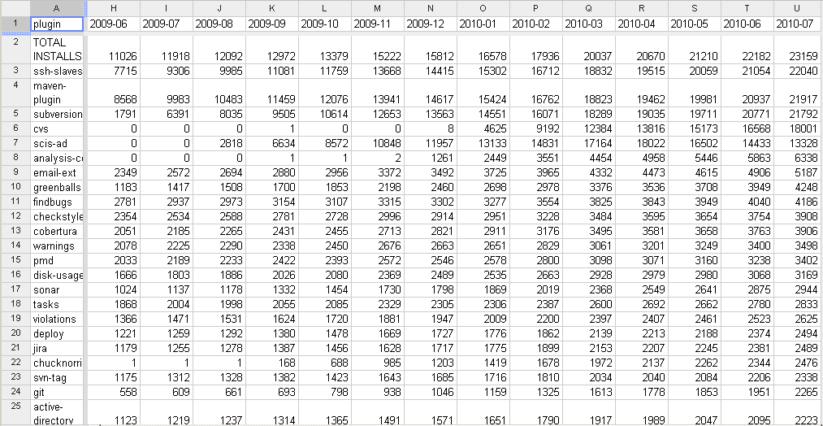
Plugin Usage Statistics
Ref: http://jenkins-ci.org/content/updated-usage-stats-available

Slide 39
Features Not Mentioned
Matrix project
Distributed build

Slide 40
Demo

Slide 41

Questions & Answers

